Slide 1
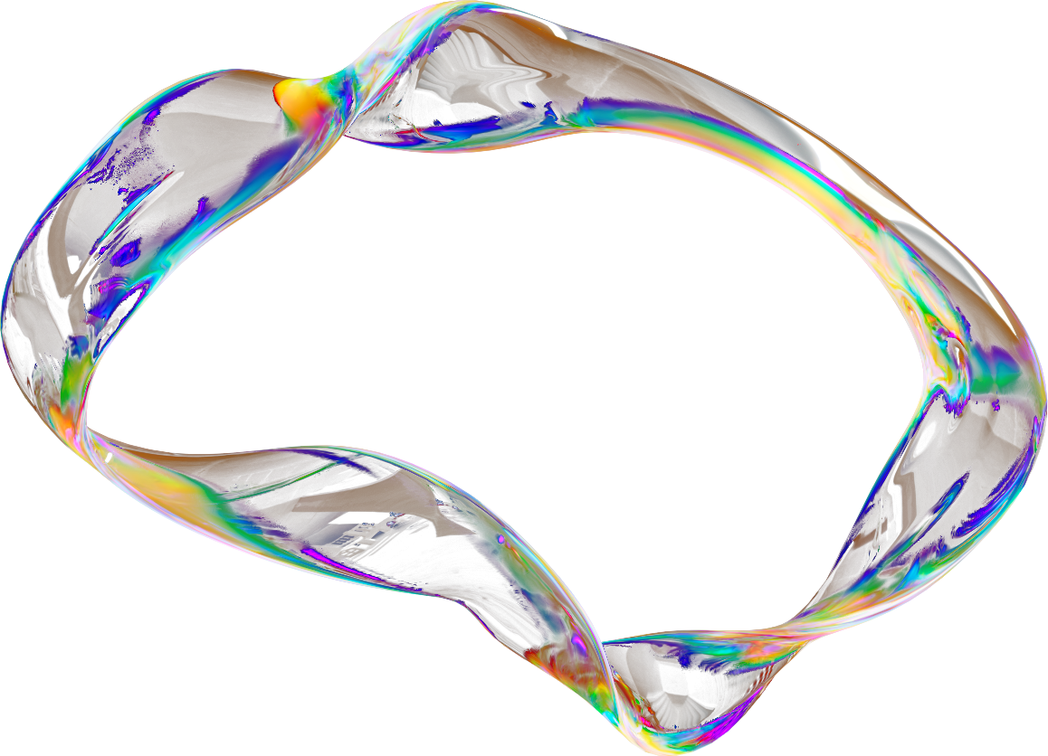



Present by Thomas Han
www.res-q.cloud
thomas.han@live.com

Slide 2
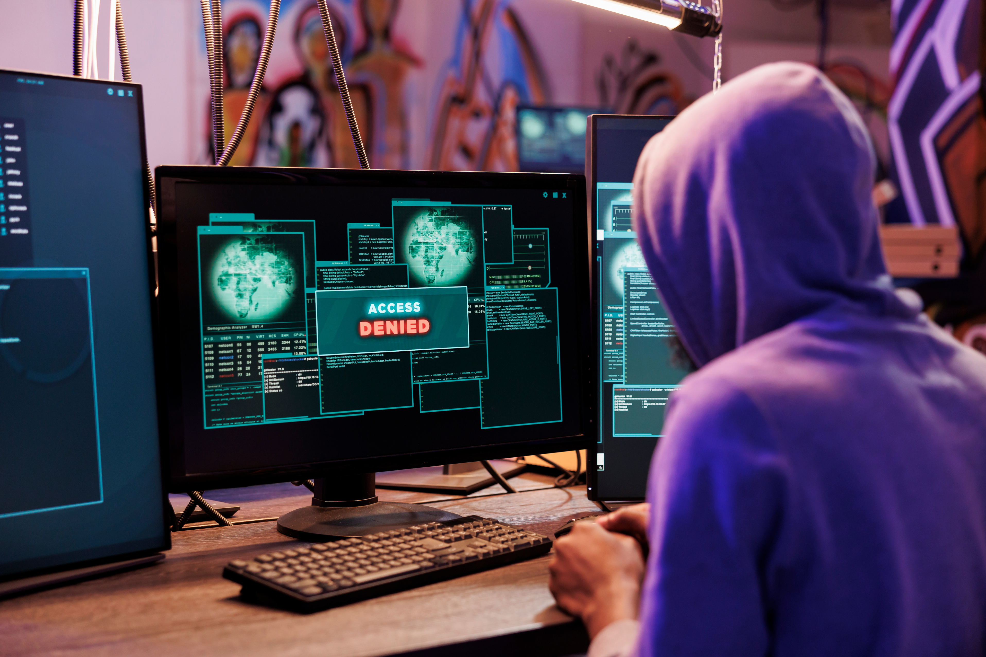

INTRODUCTION
Tale of three stories
Small Scale:
Ransomware infection on two workstations
2 hours to detect and contact MSP; 3-day recovery from backup
Recovery cost: $20,000; no impact on critical services
Medium Scale:
CrowdStrike incident on Melbourne transport company laptops
Dedicated taskforce team, productivity impacted; 5-day recovery
Recovery cost: $200,0000 - $1M; core business unaffected
Large Scale:
Major US airline, causing flight disruptions and lawsuits
Full operational halt; 5-day recovery
Recovery cost: $500M; core business crippled

Slide 3


Lack of Resilience in Non-Cloud IT Infrastructure
Non-cloud infrastructure is vulnerable to single points of failure, where a single hardware or software issue can disrupt entire systems. This risk affects all operating systems and devices, exposing them to breakdowns, errors, and cyberattacks. Recovery often demands slow, costly, and error-prone manual intervention, leading to prolonged downtimes and significant operational disruptions.
High Costs and Inefficiency of Cloud Solutions
Cloud solutions, while offering more resilience, come with high operational costs. Many organisations struggle with excessive cloud expenses and inefficient resource use, prompting them to seek cost-saving measures or alternative solutions to regain control over their IT budgets and reduce waste.
PROBLEM STATEMENT
Inadequacy of Traditional Security Measures
Conventional cybersecurity tools (e.g. antivirus, EDR) are insufficient against advanced exploits targeting system vulnerabilities, especially in non-cloud infrastructure. These systems lack effective remediation capabilities, leading to long downtime and limited recovery options when systems are compromised.

Slide 4
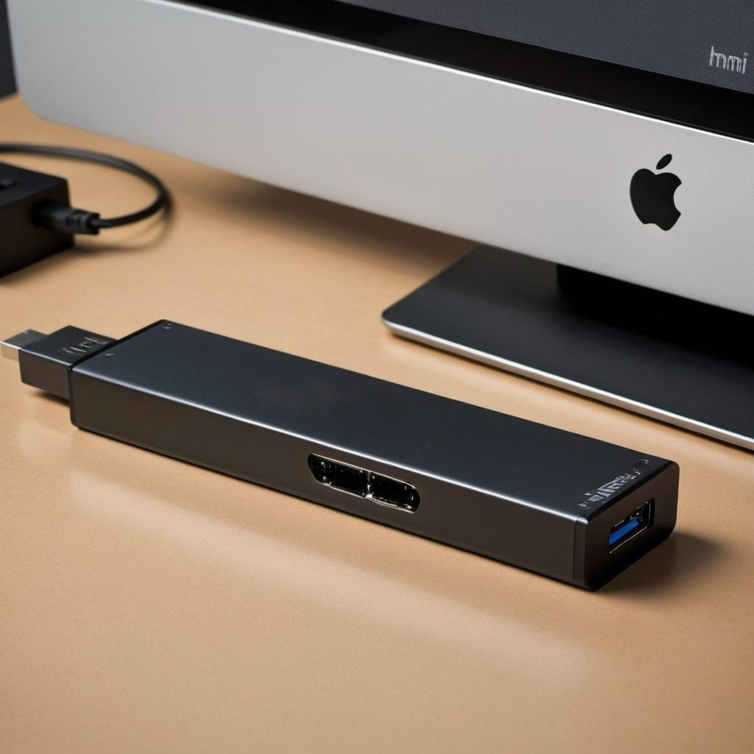

SOLUTION
SIDECAR DEVICE
CONTROL SERVER
Fully-fledged computer
Secure connection to control server over 4G
Plug-and-play to each target device
Enables full control of target device
Threat detection
Sends target device diagnostic, such as threat information to control server
Individually or mass control target devices
Mass automation scripting
Monitor target and sidecar devices
Sends automated recovery steps to sidecar
Integration to third-party tools (BCMS, monitoring)
Sends alerts to users

Slide 5



OUR INNOVATIVE SOLUTIONS -
TAKE TOTAL CONTROL
Last Line of Defence
Rapid Recovery
Private Cloud
Delivers robust protection against both known and emerging threats, ensuring seamless business continuity. Proactively detects vulnerabilities and offers resilient shielding, even if primary defences are breached. Air-gapped management prevents escalation of cyberattacks.
Reducing Mean Time to Recovery (MTTR) from 72 hours to 30 seconds drastically cuts downtime, quickly resuming critical systems. It also offers mass control, efficiently managing large-scale operations across multiple systems.
Our solutions enable complete control over private cloud environments, ensuring data security and compliance. Customise resources to meet your organisation’s specific needs while optimising efficiency.

Slide 6
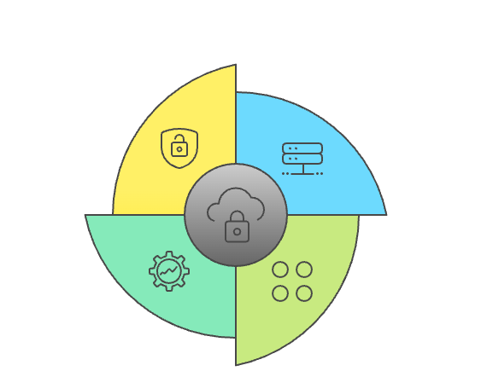

DIRECT COMPETITOR
No direct competitors
INDIRECT COMPETITOR
BCMS: ServiceNow, Battleground
IP-KVM: Sipeed NanoKVM, PiKVM, TinyPilot
Comms: Tailscale, Twingate, Headscale, NetBird
Cybersecurity: McAfee, Norton, CrowdStrike, SentinelOne, Splunk, Wazuh
ResQ Cloud

Slide 7
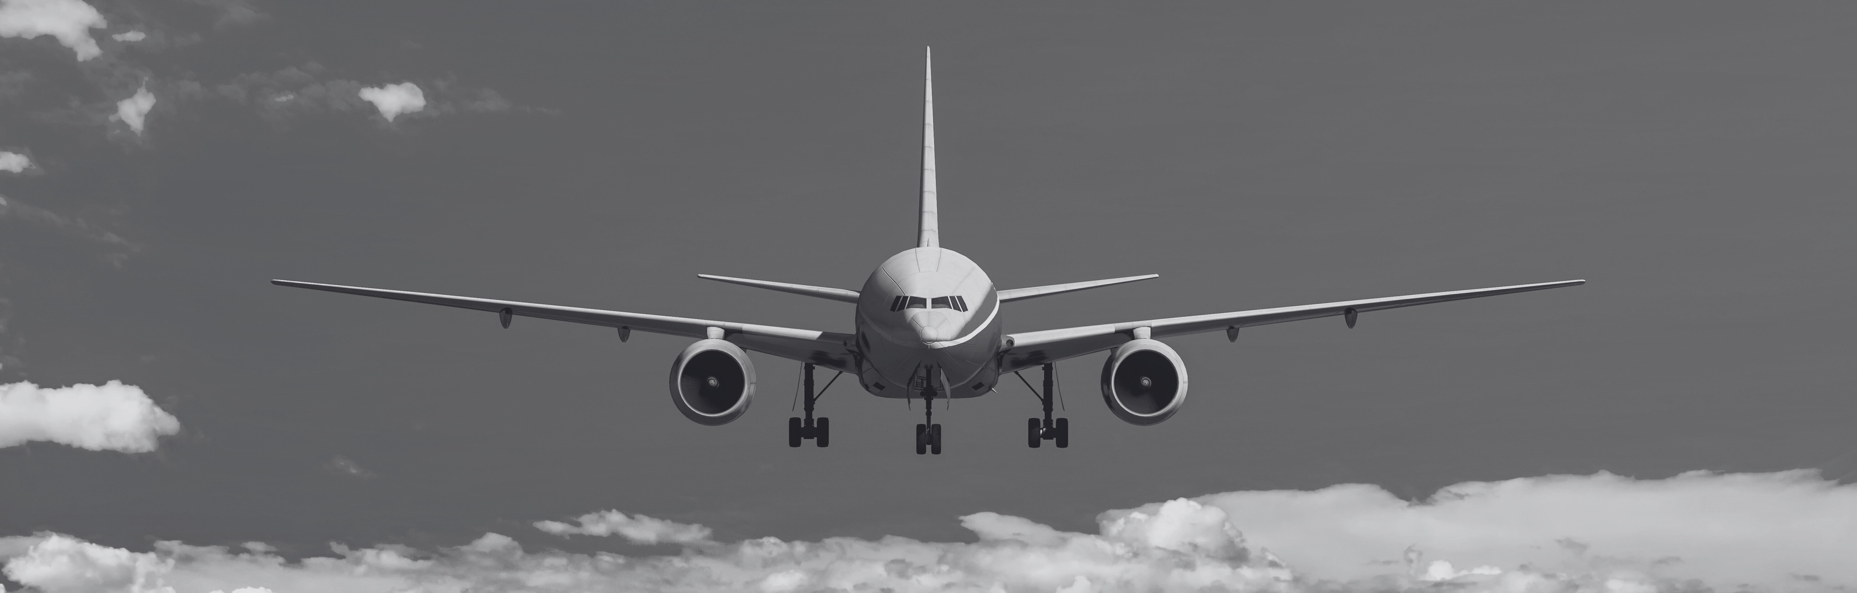
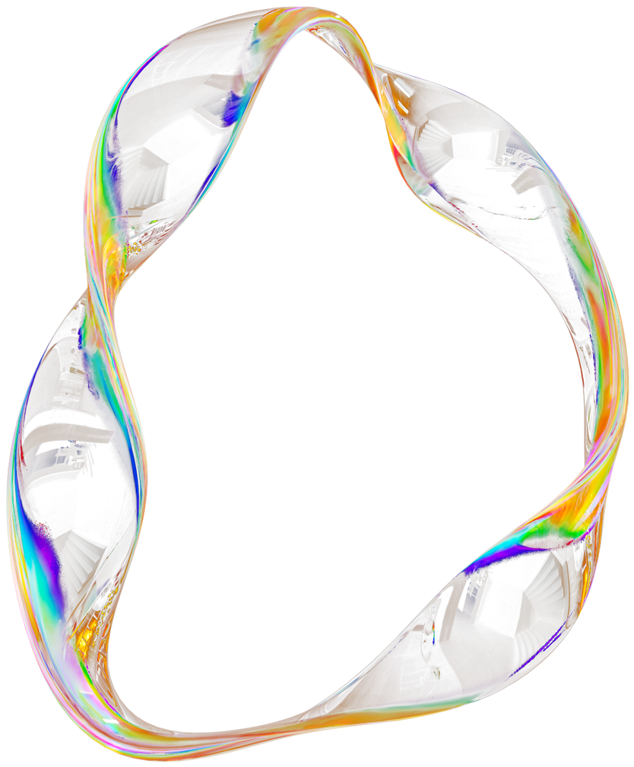
KEY COMPETITIVE ADVANTAGES
Seamless Integration
Proactive
We create a unified resilience platform by integrating with industry-standard BCMS solutions, security, monitoring, and observability tools, eliminating silos and enhancing overall security effectiveness.
Our system continuously monitors, identifies, and automatically responds to potential threats before they can cause significant damage to your infrastructure.
Private Cloud
100% Resilience - Sidecar Mode
Take total control of your private cloud infrastructure and data to maximise ROI while minimising operational costs and dependencies on public cloud providers.
By operating independently in sidecar mode, we guarantee total control over systems even when target nodes or primary networks are fully compromised.

Slide 8
Automate Mass Recovery
Cybersecurity
SOM: US$162M (30%)
SOM: US$60M (1%)
SIZE OF MARKET
SAM: US$540M (10%)
SAM: US$6B (1%)
TAM: US$5.4B
TAM: US$600B
There are numerous markets to tap into, each filled with significant potential for growth. The sizes of these global markets are:
Automate Mass Recovery
Cybersecurity
Private Cloud
By strategically targeting these areas, we believe we can harness substantial opportunities for growth and establish a strong presence in the market.
Private Cloud
SOM: US$5.2M (1%)
SAM: US$520M (10%)
TAM: US$5.2B

Slide 9
BUSINESS MODEL
Core
Secure+
CloudControl
Pricing | $15/month/device | $25/month/device | $10/month/device
Features | All features work independently of the primary network Alert on unexpected hardware/software failures Monitor and control over a single device or fleet OS (re)installation and management Snapshot and recovery Third-party integration to BCMS, monitoring, observability tools | All features from core Proactive detection and recovery Cybersecurity protection (Anti-virus, XDR, SIEM) Automated recovery from cyberattacks | Use your hardware to build and manage your private cloud

Slide 10
TRACTION & ROADMAP
Present
Present - Apr 25
Apr 25 - Oct 25
Oct 25 - Future
Customer discovery with 20+ business resilience/continuity experts
Future outreaches will include resilience operations, cybersecurity, and cloud experts
Finish hardware prototype
Build software MVP for mass monitoring/control
Continue customer discovery
Customer validation
Patent technologies
Start pilot
Customer validation for feature priorities
Based on feedback, build prioritised features
Acquire first five customers
Based on feedback build prioritised features
Scale out
Acquire 100 customers

Slide 11
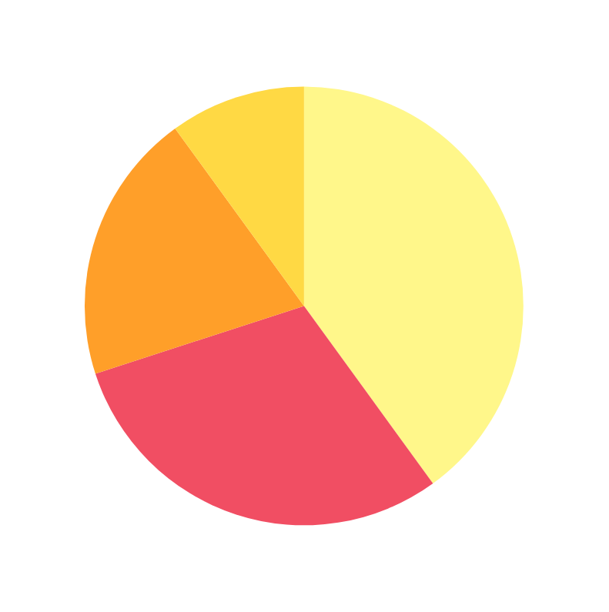
ASKS & USE OF FUNDS
Pre-seed: AU$1M
Interested in talking to people:
works in a government department that requires 100% IT resiliency
involved in recovering from CrowdStrike incident
recovered by cyberattack in a non-cloud environment recently
A. 40% R&D Hardware/Software
B. 30% Cybersecurity Solution
C. 20% International Patent
D. 10% Expansion and Growth Initiatives

Slide 12
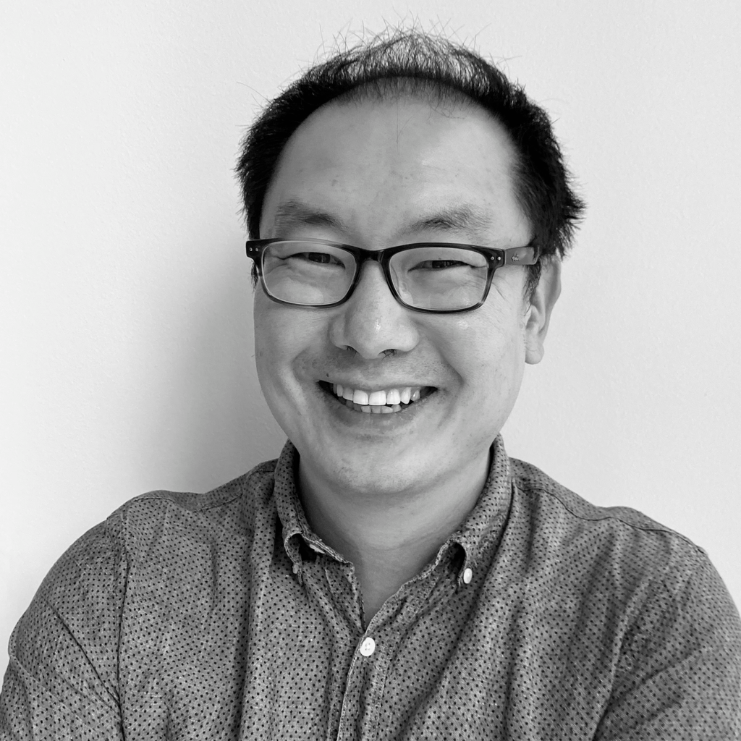
FOUNDER
Thank you for your time! Reach out to us for questions.
THOMAS
HAN
20+ years experience in IT as a software engineer/architect
Firsthand experience in operating non-cloud infrastructure
Worked across multiple sectors: banking, trading, logistics, AdTech, telecommunication, energy

Slide 13
THANK YOU
for your time and attention
Present by Thomas Han
www.res-q.cloud
thomas.han@live.com

